Slide 1

NLP Python Basics

Slide 2
Natural Language Processing
Section Goals
  Set up Spacy and Language Library
  Understand Basic NLP Topics
    Tokenization
    Stemming
    Lemmatization
    Stop Words
  Spacy for Vocabulary Matching

Slide 3
Spacy Setup

Slide 4
Natural Language Processing
What is Spacy?
  Open Source Natural Language Processing Library.
  Designed to effectively handle NLP tasks with the most efficient implementation of common algorithms.

Slide 5
Natural Language Processing
What is Spacy?
  For many NLP tasks, Spacy only has one implemented method, choosing the most efficient algorithm currently available.
  This means you often don’t have the option to choose other algorithms.

Slide 6
Natural Language Processing
What is NLTK?
  NLTK - Natural Language Toolkit is a very popular open source.
  Initially released in 2001, it is much older than Spacy (released 2015).
  It also provides many functionalities, but includes less efficient implementations.

Slide 7
Natural Language Processing
NLTK vs Spacy
  For many common NLP tasks, Spacy is much faster and more efficient, at the cost of the user not being able to choose algorithmic implementations.

Slide 8
Natural Language Processing
NLTK vs Spacy
  However, Spacy does not include pre-created models for some applications, such as sentiment analysis, which is typically easier to perform with NLTK.

Slide 9
Natural Language Processing
NLTK vs Spacy
  Due to Spacy’s state of the art approach and efficiency, we will focus on Spacy, but use NLTK when it is easier to use.

Slide 10
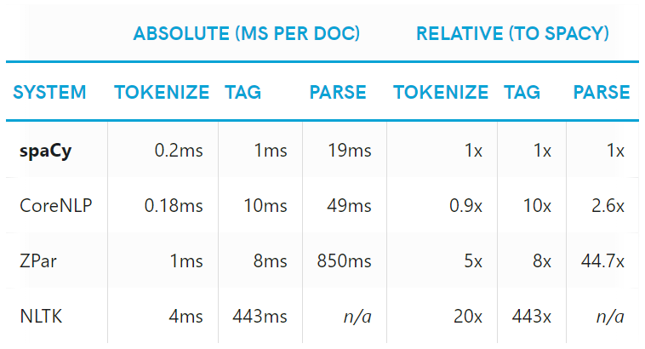
Natural Language Processing
NLTK vs Spacy Processing Tests

Slide 11
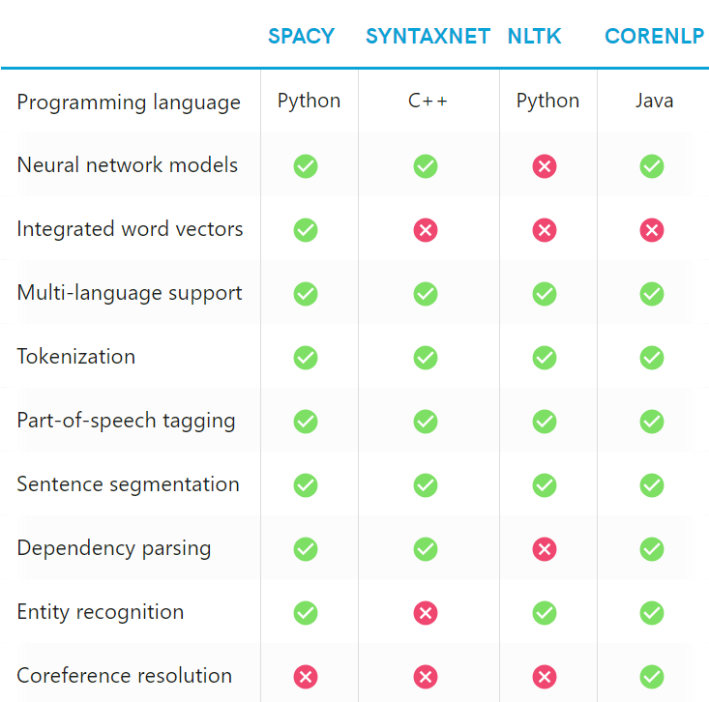
Natural Language Processing
https://spacy.io/usage/facts-figures

Slide 12
Natural Language Processing
https://spacy.io/usage/facts-figures

Slide 13
What is NLP?

Slide 14
What is NLP?
According to wikipedia,
"Natural language processing (NLP) is
an area of computer science and artificial intelligence concerned with the interactions between computers and human (natural) languages, in particular how to program computers to process and analyze large amounts of natural language data.
Source: https://en.wikipedia.org/wiki/Natural_language_processing

Slide 15
Natural Language Processing
Often when performing analysis, lots of data is numerical, such as sales numbers, physical measurements, quantifiable categories.
Computers are very good at handling direct numerical information.
But what do we do about text data?

Slide 16
Natural Language Processing
As humans we can tell there is a plethora of information inside of text documents.
But a computer needs specialized processing techniques in order to “understand” raw text data.
Text data is highly unstructured and can be in multiple languages!

Slide 17
Natural Language Processing
Natural Language Processing attempts to use a variety of techniques in order to create structure out of text data.
In this section we will be discussing some of these basic techniques, which are built into libraries such as Spacy and NLTK.

Slide 18
Natural Language Processing
Example Use Cases:
  Classifying Emails as Spam vs Legitimate
  Sentiment Analysis of Text Movie Reviews
  Analyzing Trends from written customer feedback forms.
  Understanding text commands, “Hey Google, play this song”.

Slide 19
Natural Language Processing
Natural Language Processing is constantly evolving and great strides are made every month!
We will focus on fundamental ideas that all state of the art techniques are based off.
Let’s begin by learning about the basics of using the Spacy library.

Slide 20
Spacy Basics

Slide 21
Natural Language Processing
There are a few keys steps for working with Spacy :
  Loading the Language Library
  Building a Pipeline Object
  Using Tokens
  Parts-of-Speech Tagging
  Understanding Token Attributes

Slide 22
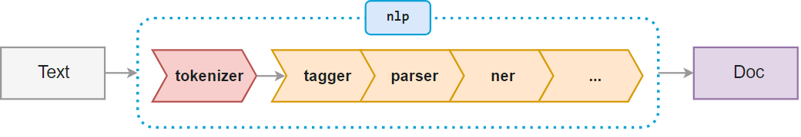
Natural Language Processing
Spacy works with a Pipeline object

Slide 23
Natural Language Processing Bootcamp
The nlp() function from Spacy automatically takes raw text and performs a series of operations to tag, parse, and describe the text data.

Slide 24
Tokenization

Slide 25
Natural Language Processing Bootcamp
Tokenization is the process of breaking up the original text into component pieces (tokens).

Slide 26
Tokenization
“We’re moving to L.A.!”
original text
“We’re
moving
to
L.A.!”
split on whitespace
“
We’re
moving
to
L.A.!”
prefix
“
We
‘re
moving
to
L.A.!”
exception
“
We
‘re
moving
to
L.A.!
”
suffix
“
We
‘re
moving
to
L.A.
!
”
exception
“
We
‘re
moving
to
L.A.
!
”
done

Slide 27
Natural Language Processing Bootcamp
Notice that tokens are pieces of the original text.
We don't see any conversion to word stems or lemmas (base forms of words) and we haven't seen anything about organizations/places/money etc.

Slide 28
Natural Language Processing Bootcamp
Tokens are the basic building blocks of a Doc object - everything that helps us understand the meaning of the text is derived from tokens and their relationship to one another.

Slide 29
Tokenization
Prefix: Character(s) at the beginning
Suffix: Character(s) at the end
Infix: Character(s) in between
Exception: Special-case rule to
split a string into several tokens
or prevent a token from being split when punctuation rules are applied
$ ( “ ¿
km ) , . ! ”
- -- / …
let’s U.S.

Slide 30
Natural Language Processing Bootcamp
Tokens have a variety of useful attributes and methods.
Let’s explore tokens with Spacy in further detail!

Slide 31
Stemming

Slide 32
Natural Language Processing Bootcamp
Often when searching text for a certain keyword, it helps if the search returns variations of the word.
For instance, searching for "boat" might also return "boats" and "boating". Here, "boat" would be the stem for [boat, boater, boating, boats].

Slide 33
Natural Language Processing Bootcamp
Stemming is a somewhat crude method for cataloging related words; it essentially chops off letters from the end until the stem is reached.
This works fairly well in most cases, but unfortunately English has many exceptions where a more sophisticated process is required.

Slide 34
Natural Language Processing Bootcamp
In fact, spaCy doesn't include a stemmer, opting instead to rely entirely on lemmatization.

Slide 35
Natural Language Processing Bootcamp
One of the most common - and effective - stemming tools is Porter's Algorithm developed by Martin Porter in 1980.
The algorithm employs five phases of word reduction, each with its own set of mapping rules.

Slide 36
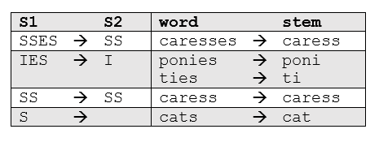
Natural Language Processing Bootcamp
In the first phase, simple suffix mapping rules are defined, such as:

Slide 37
Natural Language Processing Bootcamp
From a given set of stemming rules only one rule is applied, based on the longest suffix S1. Thus, caresses reduces to caress but not cares.

Slide 38
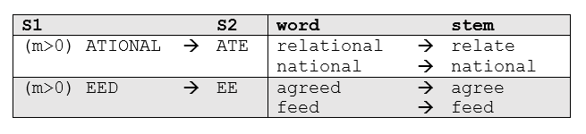
Natural Language Processing Bootcamp
More sophisticated phases consider the length/complexity of the word before applying a rule. For example:

Slide 39
Natural Language Processing Bootcamp
Snowball is the name of a stemming language also developed by Martin Porter.
The algorithm used here is more accurately called the "English Stemmer" or "Porter2 Stemmer".
It offers a slight improvement over the original Porter stemmer, both in logic and speed.

Slide 40
Natural Language Processing Bootcamp
Let’s use Python and NLTK to show how to use these stemmers!

Slide 41
Lemmatization

Slide 42
Natural Language Processing Bootcamp
In contrast to stemming, lemmatization looks beyond word reduction, and considers a language's full vocabulary to apply a morphological analysis to words.
The lemma of 'was' is 'be' and the lemma of 'mice' is 'mouse'. Further, the lemma of 'meeting' might be 'meet' or 'meeting' depending on its use in a sentence.

Slide 43
Natural Language Processing Bootcamp
Lemmatization is typically seen as much more informative than simple stemming, which is why Spacy has opted to only have Lemmatization available instead of Stemming.

Slide 44
Natural Language Processing Bootcamp
Lemmatization looks at surrounding text to determine a given word's part of speech, it does not categorize phrases.
For now, let’s learn how to perform lemmatization with Spacy.

Slide 45
Stop Words

Slide 46
Natural Language Processing Bootcamp
Words like "a" and "the" appear so frequently that they don't require tagging as thoroughly as nouns, verbs and modifiers.
We call these stop words, and they can be filtered from the text to be processed.
Spacy holds a built-in list of some 305 English stop words.

Slide 47
Vocabulary and Matching

Slide 48
Natural Language Processing Bootcamp
So far we've seen how a body of text is divided into tokens, and how individual tokens are parsed and tagged with parts of speech, dependencies and lemmas.

Slide 49
Natural Language Processing Bootcamp
We can think of this as a powerful version of Regularof speech into account for our pattern search.
Let’s explore this with Spacy!
Expression where we actually take parts

